Slide 1
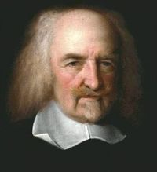
Thomas Hobbes 1588-1679

Slide 2
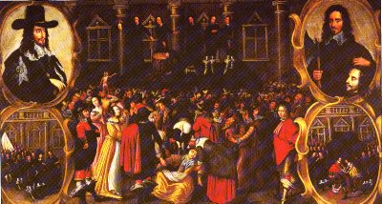
The Execution of Charles I 30th Jan 1649

Slide 3
Sensations
We are born as a blank slate - all of our thoughts come to us through our senses.
A sensation is caused by an external object working on the senses
External objects are not intelligible in themselves – they only exist insofar as they strike our senses
All motion is caused by external objects.
Freedom is unimpeded movement - the absence of external physical constraint.

Slide 4
Imagination and Thought
Imagination is nothing more than decaying sense – a imprint on your senses from the external world which is slowly fading.
We cannot imagine what we haven’t seen before in the external world.
Dreams are produced by inner agitations of the organs
Thought processes – two kinds:
  Unguided wandering thoughts without any kind of direction
  Regulated thoughts guided by desire or fear.

Slide 5
Passions
When we desire something we are impelled or drawn towards an external object which causes it.
When we have an aversion to something we are repelled by an object.
Basic passions: Appetite, Desire, Love, Aversion, Hate, Joy and Grief
Felicity (happiness): is the continual success in obtaining the objects that we desire.
Virtues: What is valued in us by others; the qualities and abilities which others value and want in themselves.

Slide 6
Power
“The Power of a Man is his present means to attain some future apparent Good”. Power is the ability to get what you desire
  ‘Natural power’: the abilities one has to begin with – Strength, Eloquence, Prudence, Nobility.
  ‘Instrumental power’: powers which are acquired as a result of these natural powers: Riches, Reputation, Friends, Good Luck
    Eg. To have friends and servants is power – because these people can do things for you.
The Value (Price) of a person is determined by others – the extent to which one’s abilities are valued in certain situations.

Slide 7
Human Nature
The object of man’s desire and ambitions is not to simply enjoy something once or for a finite time but rather to secure the conditions for an ongoing enjoyment.
Everyone has a general desire for power – which is continuous, ongoing and never satisfied. Not a question of greed but survival.
This desire will lead to competition for wealth, honour, power.
There is a perpetual struggle for power, honour, glory and wealth – a constant competition that takes place over scant resources.

Slide 8
Natural condition of Mankind
People are by nature largely equal in terms of faculties of body and mind.
From this equality of ability there is the equality of hope that everyone will attain their ends.
But because resources are finite, this equality of desire and ambition leads to conflict and violence
  Lack of sense of security – no way for anyone to secure themselves. No one trusts anyone else.
Three aspects of human nature that create conflict
  Competition – use of violence for gain
  Diffidence (fear) – use of violence in order to protect themselves
  Glory – use of violence to enhance their reputation, to gain reputation for power.

